Slide 1
Chart Parsing

Slide 2
Learning Outcomes
be aware of the advantages of chart parsing
understand the basic operations of the Earley algorithm

Slide 3
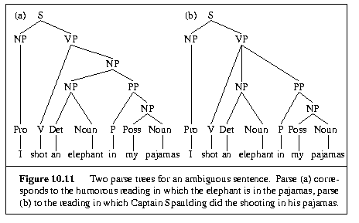
Structural Ambiguity

Slide 4
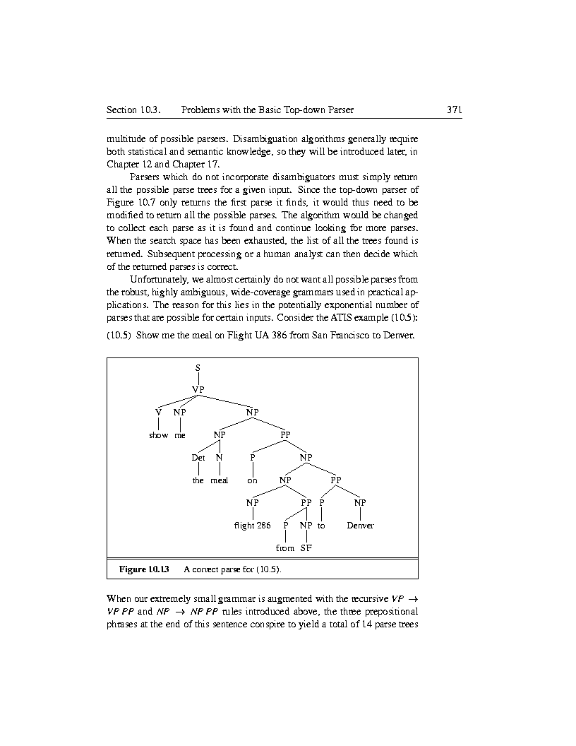
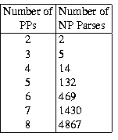
PP attachment ambiguity
Show me the meal on flight UA 386 from San Francisco to Denver
VP -> VP PP
NP -> NP PP

Slide 5
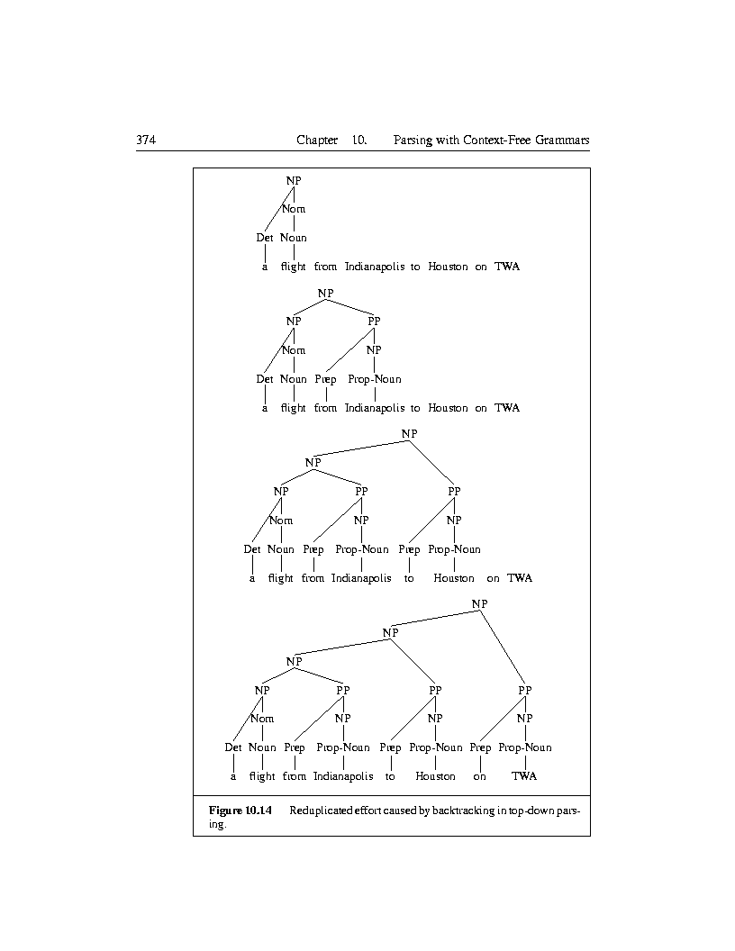
Repeated Parsing of Subtrees
a flight from Indianapolis to
Houston on TWA
a flight 4
from Indianapolis 3
to Houston 2
on TWA 1
a flight from Indianapolis 3
a flight from Indianapolis
to Houston 2
a flight from Indianapolis
to Houston on TWA 1

Slide 6
Chart parsing: Earley algorithm
chart parsing is a form of dynamic programming
dynamic programming solves problems by filling in tables with solutions to sub-problems
when complete, the tables contain all the solutions to the sub-problems needed to solve the problem
in chart parsing, this involves storing subtrees for constituents that are found
once found and stored, subtrees can be looked up - this avoids reparsing

Slide 7
What information is in a chart?
a subtree corresponding to a single grammar rule e.g. NP, Noun, etc.
information about the progress made in completing this subtree e.g. ‘how much of the NP has been processed in the subtree for NP -> D N’
the position of the subtree in relation to the input e.g. ‘NP from word 1 to word 3’

Slide 8
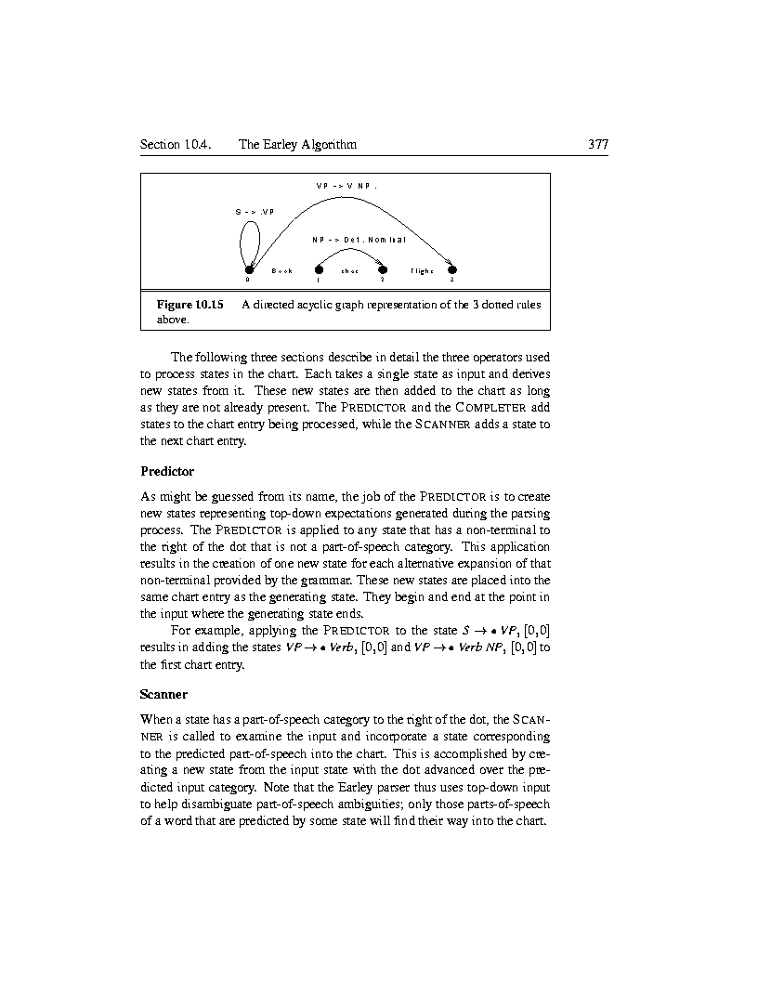
Representing States in the Chart
Book that flight
S -> .VP, [0,0]
NP -> Det . Nominal, [1,2]
VP -> V NP . , [0,3]

Slide 9
The Earley Algorithm
a chart consists of N + 1 states (where N is the number of words in the input)
the algorithm goes through the states from left to right and processes each state in order
at each step one of the following operators is applied to a state:
  predictor
  scanner
  completer
new states are added to the chart
states are never removed, there is no backtracking

Slide 10
Predictor
creates new states from top-down application of rules
new states are placed into the same chart entry as the generating state
Example
apply Predictor to the state
S -> .VP , [0,0]
results in adding the new states
VP -> .Verb, [0,0]
VP -> .Verb NP, [0,0]

Slide 11
The Predictor in Action
S -> VP
VP -> Verb
VP -> Verb NP
VP -> .Verb
VP -> .Verb NP
S -> .VP
Book that flight
0 1 2 3

Slide 12
Scanner
when there is a part of speech category to the right of the dot, the scanner incorporates a state for this part of speech into the chart
the dot advances over this category
only those parts of speech that are predicted by a state will enter the chart (top-down input used to disambiguate part-of-speech ambiguities)
Example
state to process: VP -> .Verb NP , [0,0]
scanner checks that current word is a Verb
new state created: VP -> Verb . NP , [0,1]

Slide 13
The Scanner in Action
VP -> Verb NP
Verb -> book
VP -> .Verb NP
VP -> Verb. NP
Book that flight
0 1 2 3

Slide 14
Completer
The completer is applied to a state when its dot has reached the right end of a rule - this means that a subtree has been found for some part of the input
the completer takes old states and combines them into new states
Example
completer processes state NP -> Det Nominal., [1,3]
looks for states ending at 1 and expecting an NP e.g.
VP -> Verb . NP, [0,1]
this results in a new complete state VP -> Verb NP . , [0,3]

Slide 15
The Completer in Action
VP -> Verb NP .
VP -> Verb NP
NP -> Det Nominal
NP -> Det Nominal .
Det -> that .
Nominal -> flight .
VP -> Verb. NP
Book that flight
0 1 2 3

Slide 16
Earley Algorithm: An Example
Chart [0]
γ -> .S [0,0] Dummy start state
S -> .NP VP [0,0] Predictor
NP -> .Det Nominal [0,0] Predictor
NP -> .Proper-Noun [0,0] Predictor
S -> .VP [0,0] Predictor
VP -> .Verb [0,0] Predictor
VP -> .Verb NP [0,0] Predictor
S -> .Aux NP VP [0,0] Predictor

Slide 17
Chart [1]
Verb -> book . [0,1] Scanner
VP -> Verb . [0,1] Completer
S -> VP . [0,0] Completer
VP -> Verb . NP [0,1] Completer
NP -> . Det Nominal [1,1] Predictor
NP -> .Proper-Noun [1,1] Predictor

Slide 18
Chart [2]
Det -> that . [1,2] Scanner
NP -> Det . Nominal [1,2] Completer
Nominal -> . Noun [2,2] Predictor
Nominal -> . Noun Nominal [2,2] Predictor

Slide 19
Chart [3]
Noun -> flight . [2,3] Scanner
Nominal -> Noun . [2,3] Completer
Nominal -> Noun .Nominal [2,3] Completer
NP -> Det Nominal . [1,3] Completer
VP -> Verb NP . [0,3] Completer
S -> VP . [0,3] Completer

